Slide 1
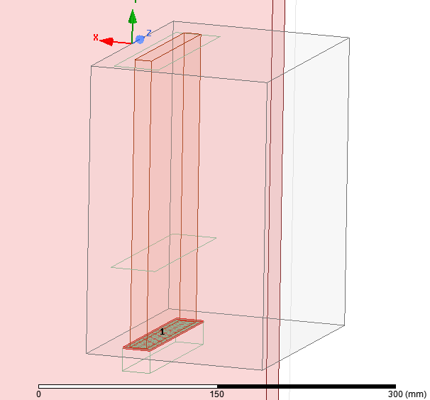
Port
short
Current evaluated @ short
Capped wave port

Slide 2
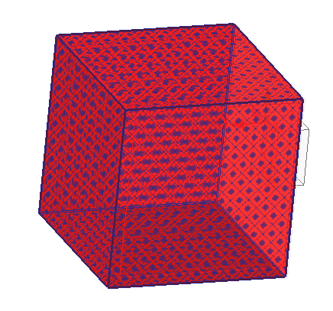
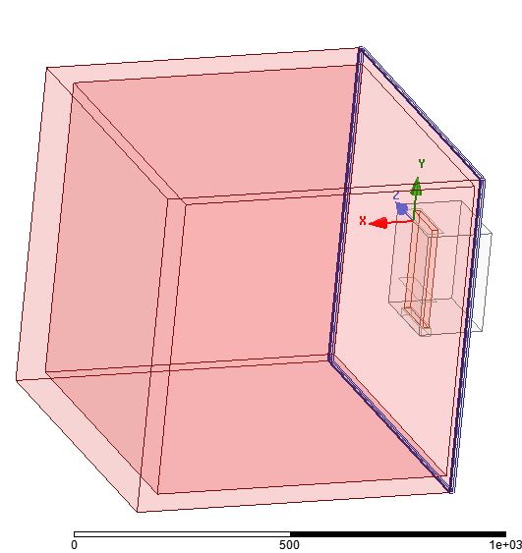
Boundary conditions
h_strap 200mm
Radiation around the dielectric
(5 faces)
Radiation around the vacuum gap (4 faces)

Slide 3

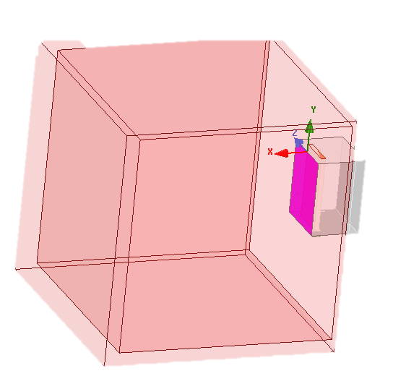
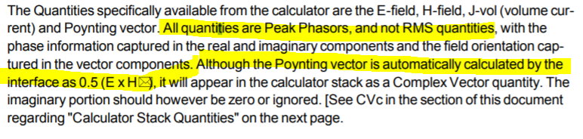
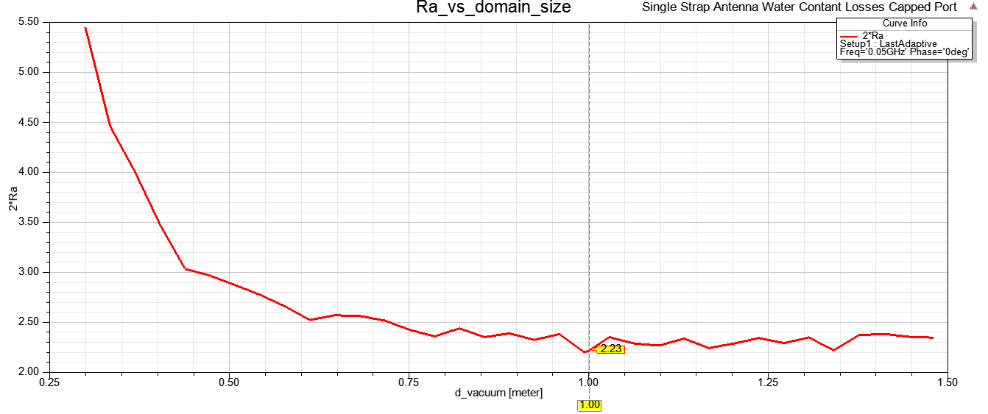
Aperture resistance
Power rad from aperture : int(Re[Poynting].dS)
Defined as :
But I_{HFSS} = I_{peak} = sqrt(2) I_{rms} but P_{rad} is time-averaged → R_{a} x sqrt(2)^2 to match ANTITER ?
Ra ~ 1,1 → 2xRa = 2,23

Slide 4
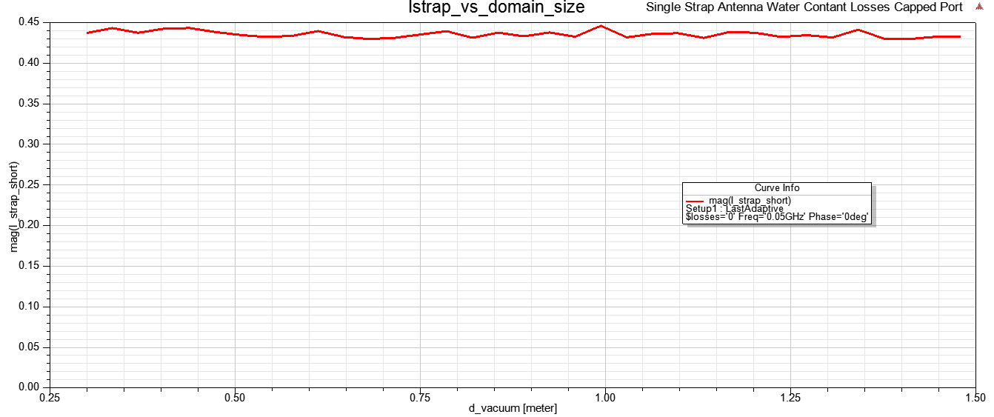
Current
Current ~ constant independently of dielectric size

Slide 5
Comparison ATT-HFSS
27-07-2018

Slide 6
Single Strap Antenna
Units:
Length: m
Density: m-3
Antenna box from x=0
Plasma from x=x_plasma
w_strap
d_wall
d_strap
y
y
e_strap
h_box
h_strap
x
z
vacuum
vacuum
w_box
d_box
h_box=0.20
w_box=0.20
h_strap=0.20 (same as h_box)
w_strap=0.12
d_wall=0.04
d_box=0.16
d_strap=0.04
e_strap=(0.015)

Slide 7
Double Straps Antenna
Units:
Length: m
Density: m-3
Antenna box from x=0
Plasma from x=x_plasma
w_strap
d_wall
delta_strap
d_strap
y
y
e_strap
h_box
h_strap
x
z
vacuum
vacuum
w_box
d_box
h_box=0.20
w_box=0.43
h_strap=0.20 (same as h_box)
w_strap=0.12
d_wall=0.045
delta_strap=0.1
d_box=0.16
d_strap=0.04
e_strap=(0.015)

Slide 8
Plasma Configurations
n_e
Units:
Length: m
Density: m-3
n_e0
Constant density plasma
0
x_plasma
x
n_e
Dn_e0
n_e1
Single gradient plasma
n_e0
0
x_plasma
x_core
x
x_plasma=0.01
ANTITER: Base density for vacuum is n_edge=1e11
This is made for numerics but has a very low impact on kperp in vacuum

Slide 9
Frist case: constant profile Single & Double strap

Slide 10
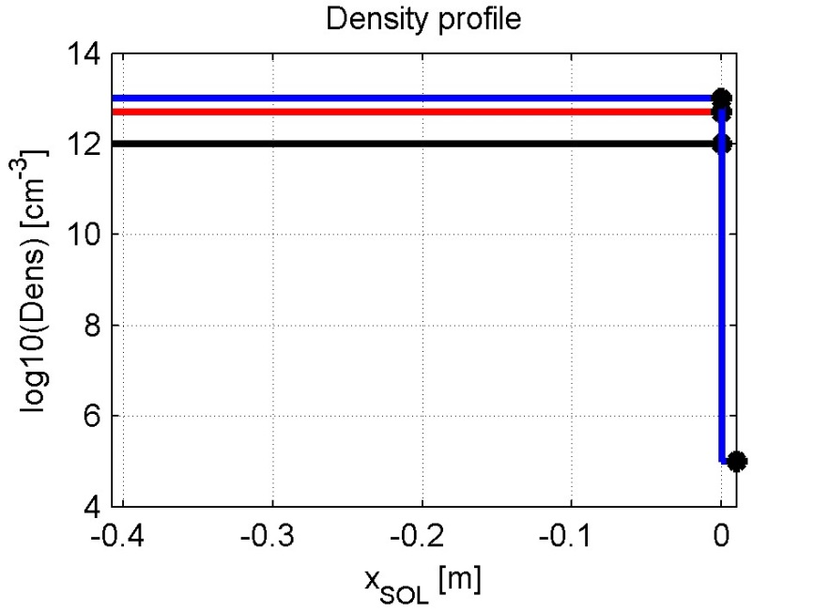
Plasma: const profile
Constant density plasma
n_e
Units:
Lengths: m
Density: m-3
!! ANTITIER
Density: cm-3
n_e0
Constant density plasma
0
x_plasma
x
x_plasma=0.01
n_e0=1e18
n_e0=5e18
n_e0=10 e18
ANTITER uses a slightly different reference system
n_e
n_e0
x
0
x_ant=x_plasma

Slide 11
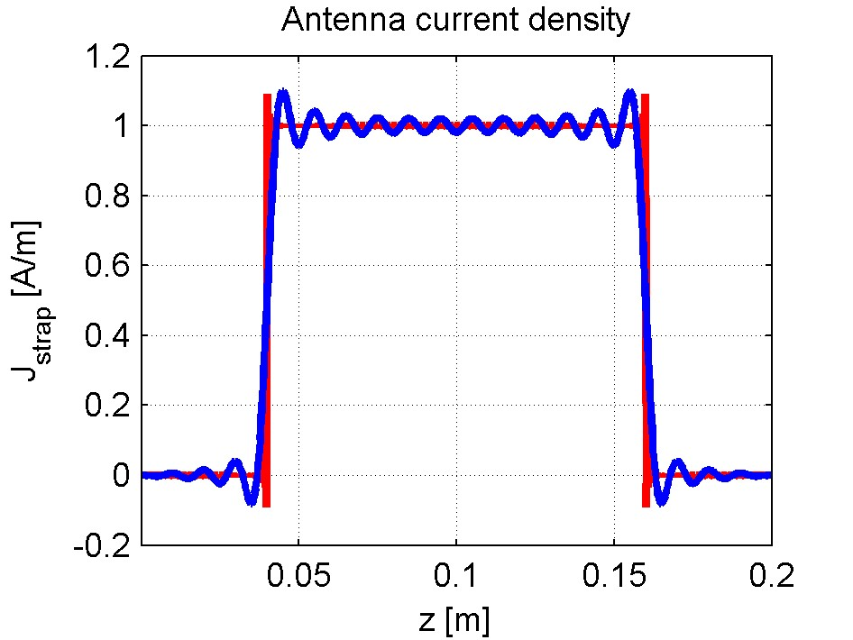
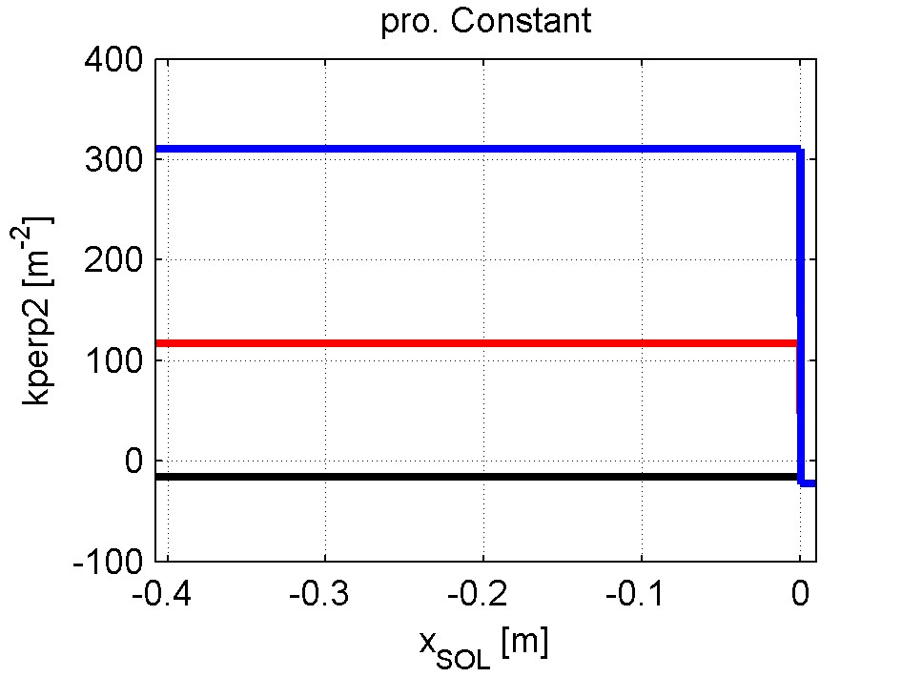
Plasma: const profile
Constant density plasma
40 elements in the expansion of J.
(Seems enough, checked for convergence. Could be increased.)
n_e0=10 e18
n_e0=5e18
f=50MHz
D(H)5%
n_e0=1e18
1e18 is below cut-off
 | 1e18 | 5e18 | 10e18
R_A (ohm/m) | 0.22 | 1.74 | 4.0
Z_A (ohm/m) | 0.22+i96.86 | 1.74+i97.47 | 4+i97.12
Z_A (ohm) | 0.044+i19.37 | 0.348+i19.49 | 0.8+i19.42
R_A is at the aperture (Poynting)
Z_A is at the strap

Slide 12
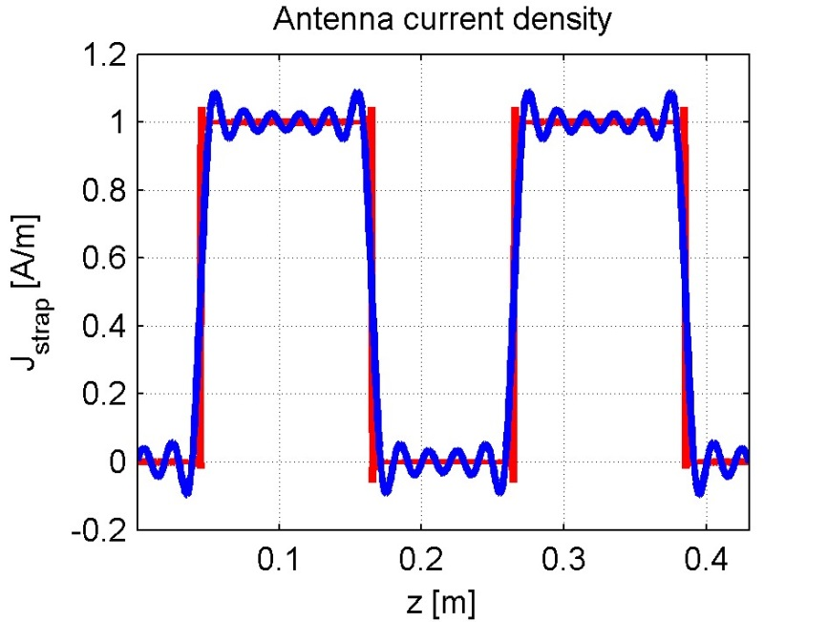
Plasma: const profile
Constant density plasma
40 elements in the expansion of J.
(Seems enough, checked for convergence. Could be increased.)
n_e0=10 e18
n_e0=5e18
f=50MHz
D(H)5%
n_e0=1e18
1e18 is below cut-off
Dipole only
 | 1e18 | 5e18 | 10e18
R_A (ohm/m) | 0.017 | 0.74 | 3.50
Z_A (ohm/m) | 0.017 + i99.4 | 0.74 + i100.14 | 3.5 + i101.55
Z_A (ohm) | 0.0035 + i19.88 | 0.15 + i20.03 | 0.7 + i20.31
Z11 = Z22 (ohm) | 0.218 + i23.31 | 1.68 + i23.52 | 2.62 + i22.39
Z21 = Z21 (ohm) | 0.215 + i3.42 | 1.53 + i3.49 | 1.92 + i2.08

Slide 13
Second case: linear profile Single & Double strap

Slide 14
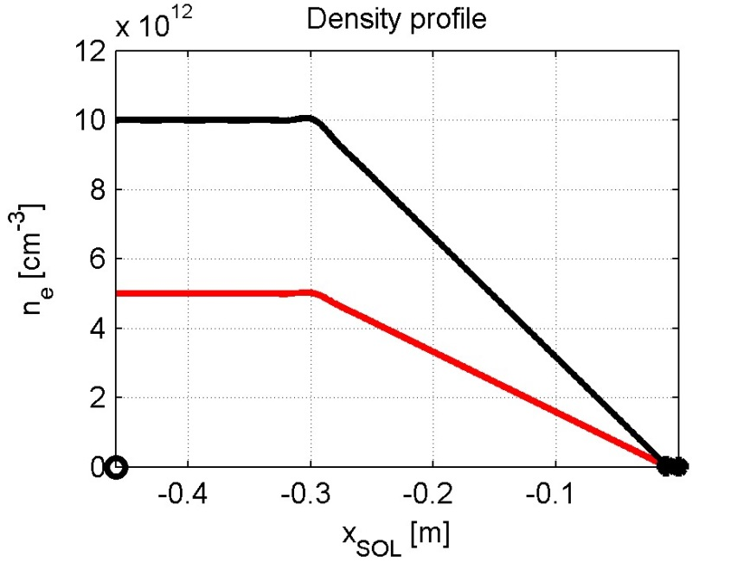
Plasma: linear profile
Constant density plasma
n_e
n_e1
Units:
Lengths: m
Density: m-3
!! ANTITIER
Density: cm-3
Dn_e0
Constant density plasma
n_e0
0
x_plasma
x_core
x
x_plasma=0.01
x_core-x_plasma=0.30
n_e0=1e15
n_e1=10 e18
n_e0=1e15
n_e1=5 e18
ANTITER uses a slightly different reference system

Slide 15
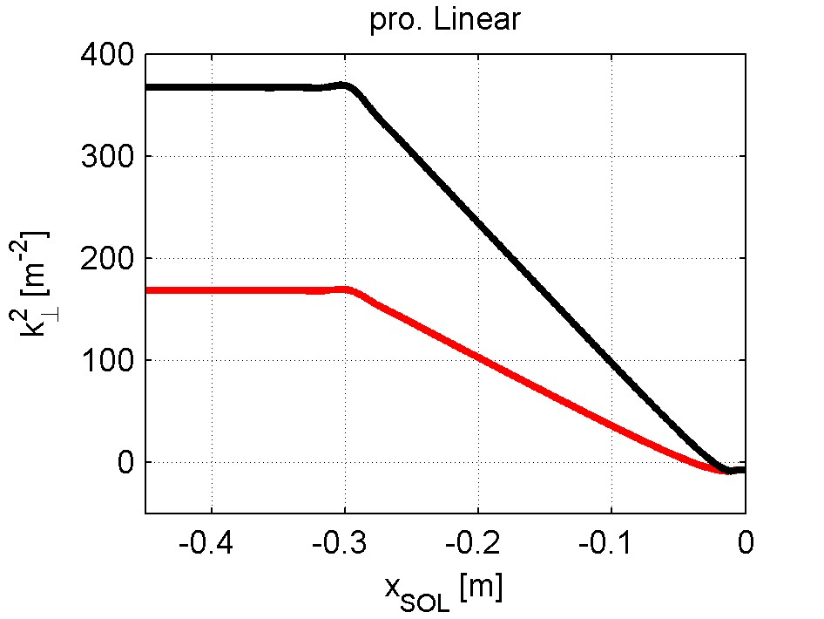
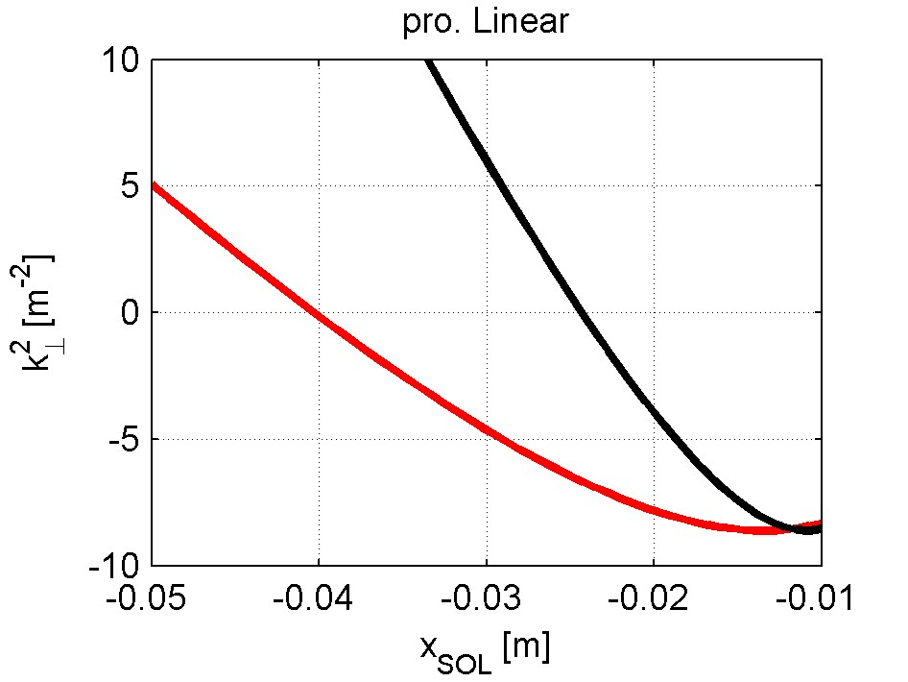
Plasma: linear profile
Constant density plasma
40 elements in the expansion of J.
(Seems enough, checked for convergence. Could be increased.)
f=50MHz
D(H)5%
Different cut-off position:
2.5cm 4cm
 | 1e15 to 10e18 | 1e15 to 5e18
R_A (ohm/m) | 0.60 | 0.23
Z_A (ohm/m) | 0.60+i96.63 | 0.23+i96.78
Z_A (ohm) | 0.12+i19.32 | 0.046+i19.35
R_A is at the aperture (Poynting)
Z_A is at the strap

Slide 16
Plasma: linear profile
Constant density plasma
40 elements in the expansion of J.
(Seems enough, checked for convergence. Could be increased.)
f=50MHz
D(H)5%
Different cut-off position:
2.5cm 4cm
Dipole only
 | 1e15 to 10e18 | 1e15 to 5e18
R_A (ohm/m) | 0.25 | 0.096
Z_A (ohm/m) | 0.25 + i99.51 | 0.096 + i99.56
Z_A (ohm) | 0.05 + i19.90 | 0.019 + i19.91
Z11 = Z22 (ohm) | 0.50 + i23.01 | 0.32 + i23.13
Z21 = Z12 (ohm) | 0.45 + i3.12 | 0.31 + i3.22

